Slide 1


Slide 2
Project Overview
AI Trading Genius leverages machine learning, real-time data analysis, and automated execution to empower traders with intelligent, data-driven decisions.
AI-Powered
Real-time
Automated
Intelligent, data-driven decisions.
Live market analysis and execution.
Streamlined trading processes.

Slide 3
Key Features: Core Functionality
Machine Learning Predictions
Risk Management & Portfolio Optimization
Analyze real-time market data
Custom stop-loss & position sizing
Generate actionable trading signals
Real-time portfolio risk scoring
Paper Trading & Live Trading Modes
Interactive Dashboard
Streamlit UI with Plotly visualizations
Safely test strategies without risking capital
Clear metrics and controls

Slide 4
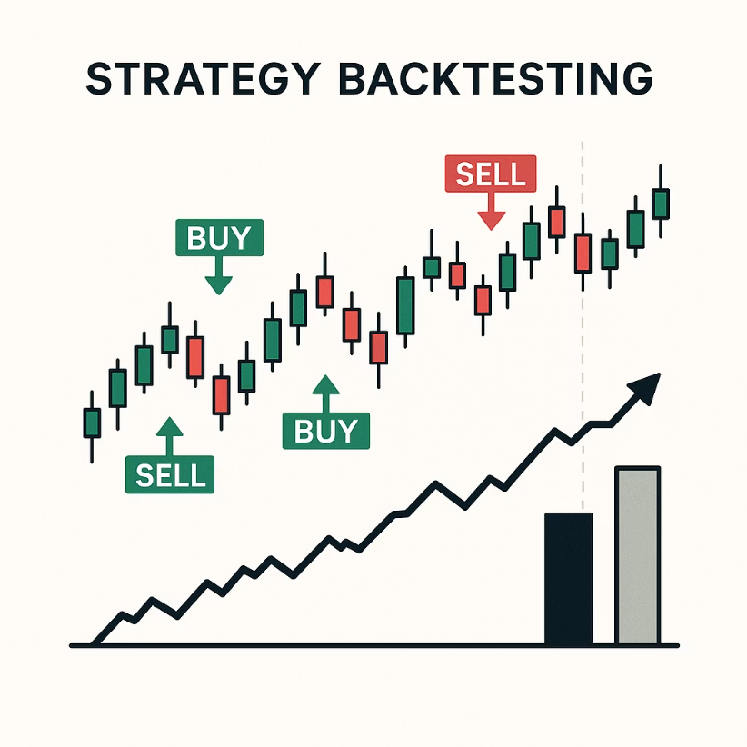



Key Features: Advanced Tools
Strategy Backtesting
Simulate performance over historical data.
Emergency Stop
Instantly halt all trading activities.

Slide 5
Technology Stack
Core Technologies
Custom ML Models & Strategies
System Modules
Portfolio Manager
Python
AI Advisor
Streamlit (Web App)
Data Processor
Backtester
Plotly (Charts & Analytics)
ML Model Manager
Trade Executor
Strategy Manager
Risk Manager

Slide 6
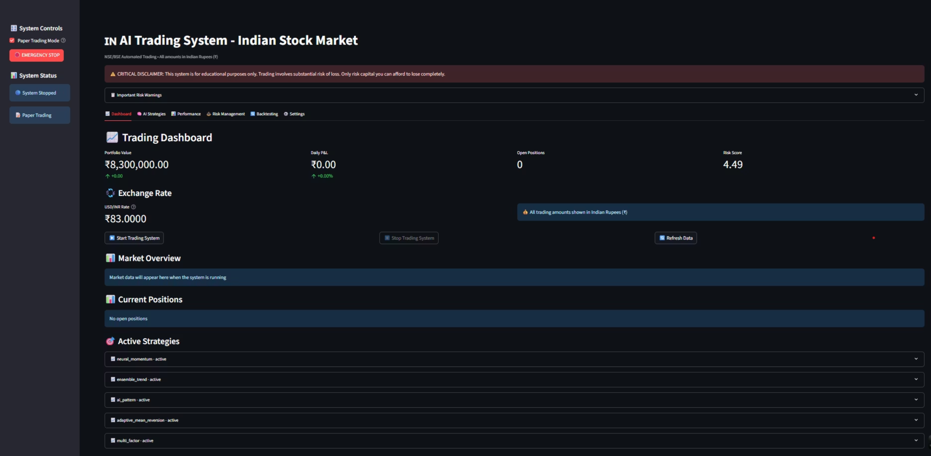
System Dashboard
The interactive dashboard provides a comprehensive overview of portfolio value, daily P&L, open positions, and risk score. All amounts are in Indian Rupees (₹).

Slide 7
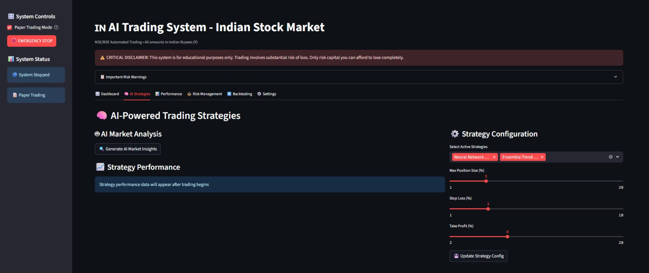
AI-Powered Trading Strategies
Configure and manage active AI strategies, including Ensemble Trend and Neural Network, with customizable max position size, stop loss, and take profit percentages.

Slide 8
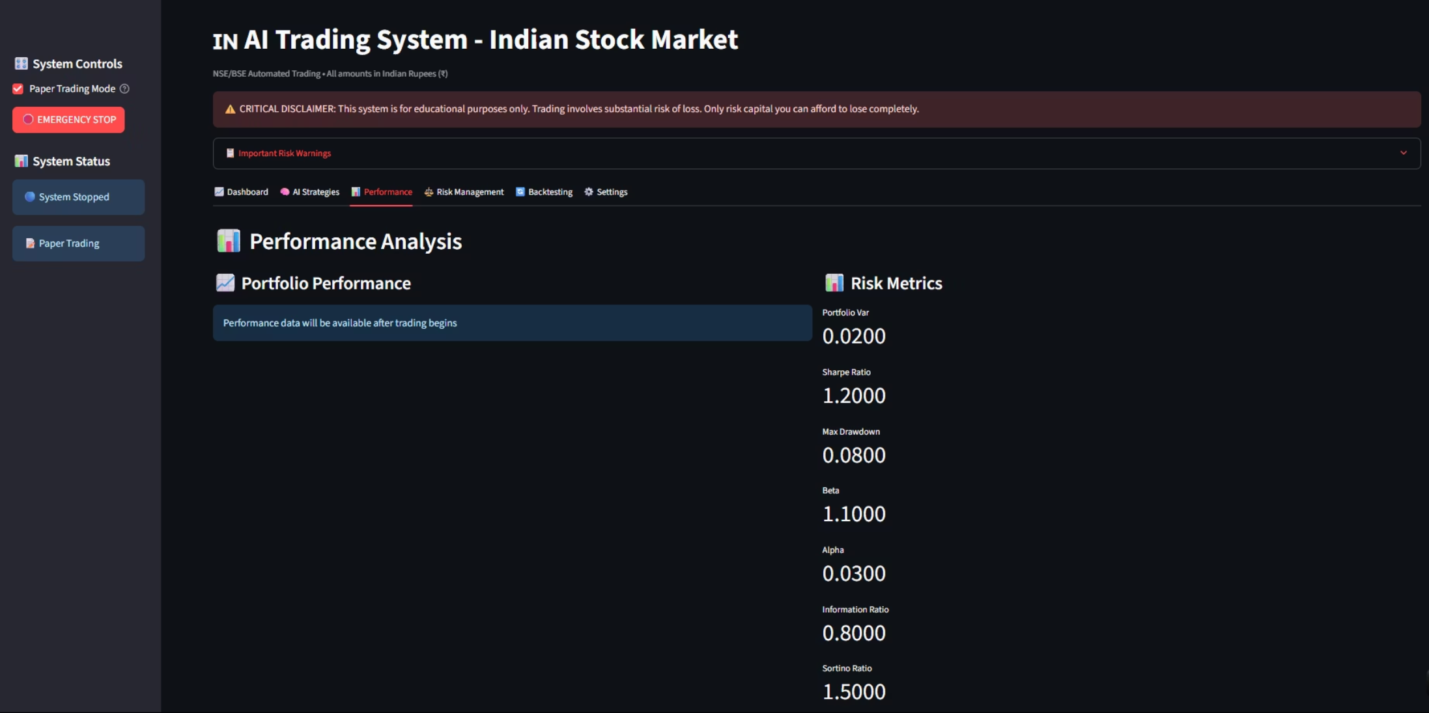
Performance Analysis
Monitor portfolio performance and key risk metrics such as Portfolio VaR, Sharpe Ratio, Max Drawdown, and Beta.
Update risk parameters for optimal control.

Slide 9
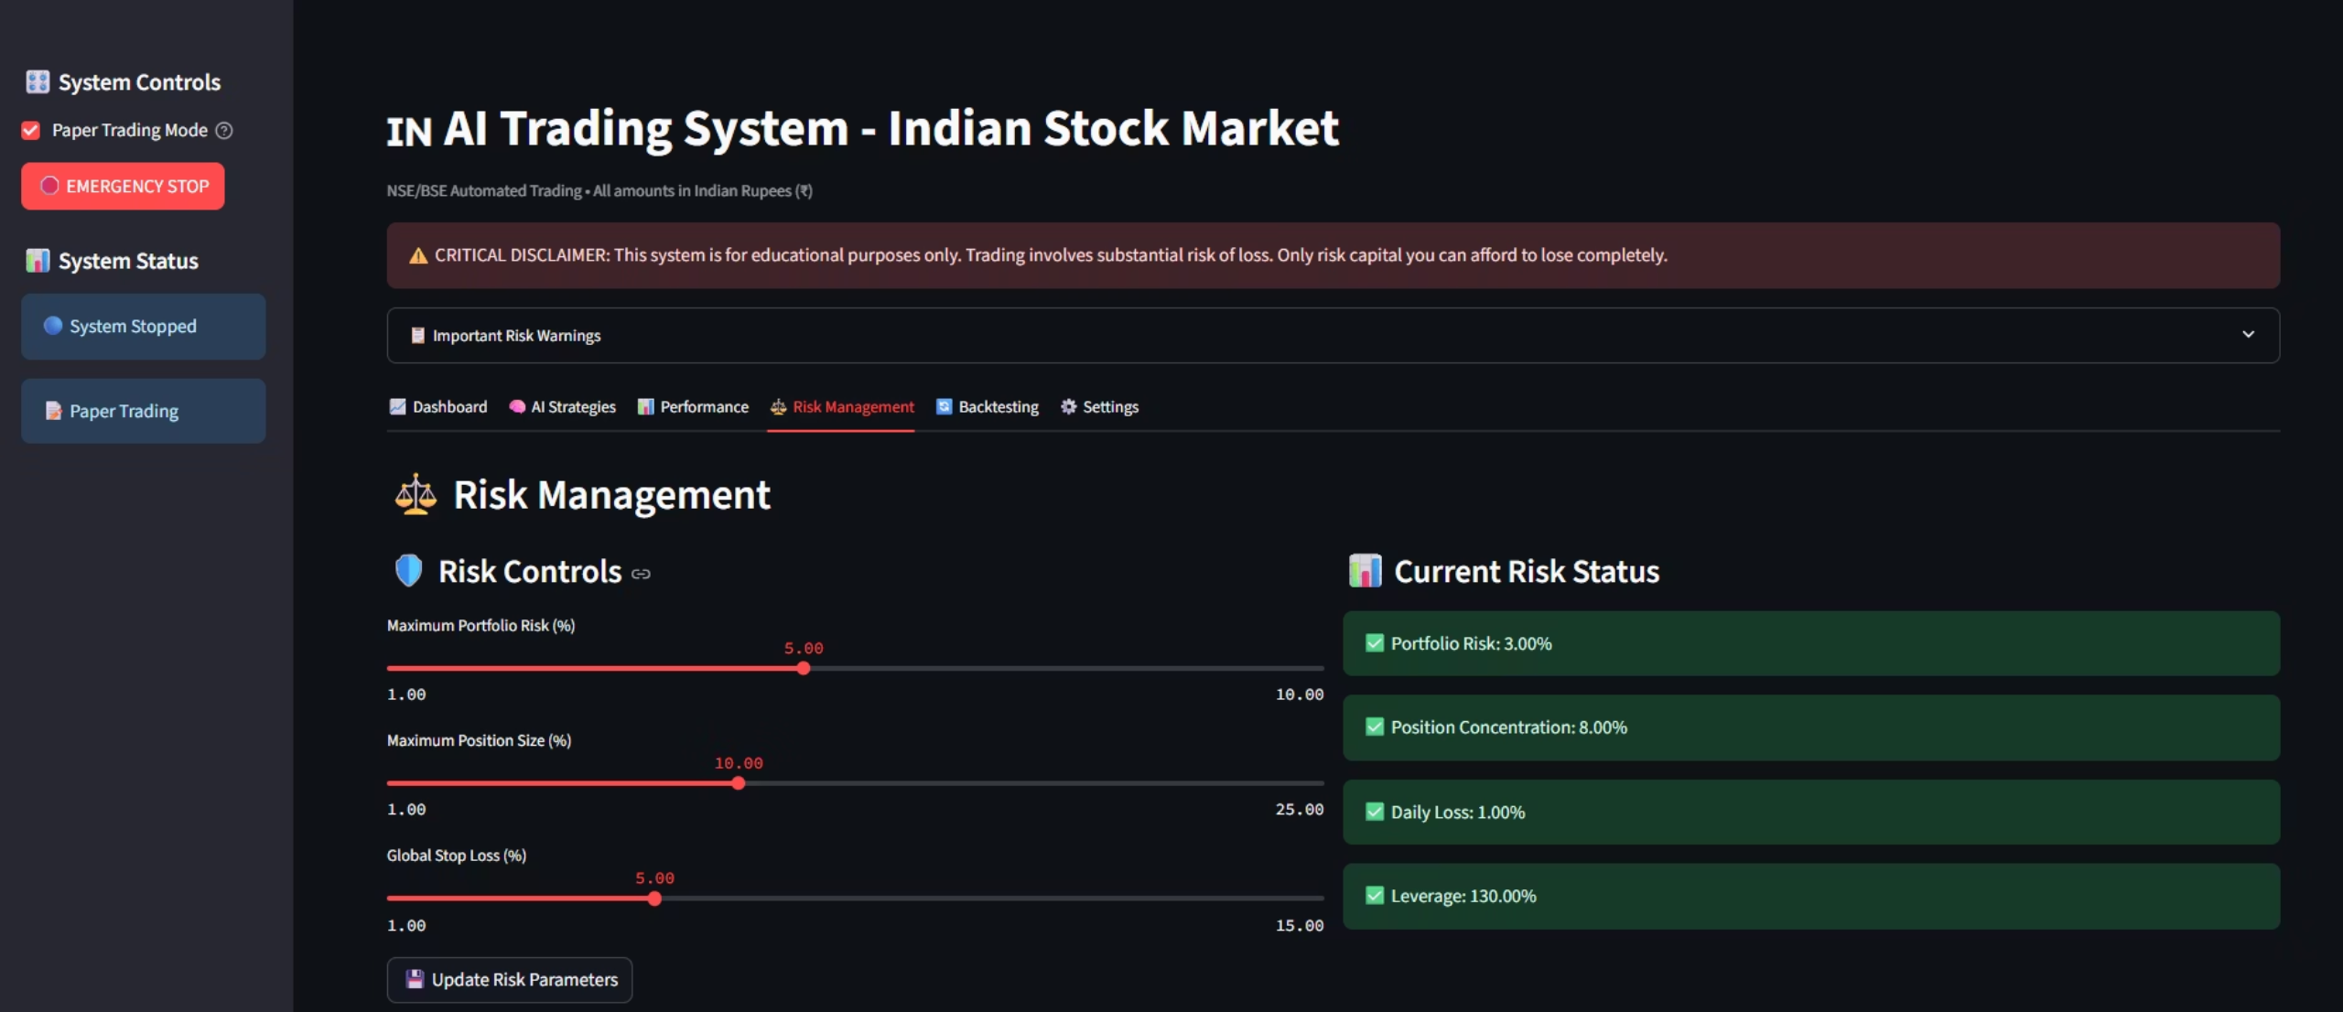
Risk Management & Portfolio Optimization
Custom stop-loss & position sizing
Real-time portfolio risk scoring

Slide 10
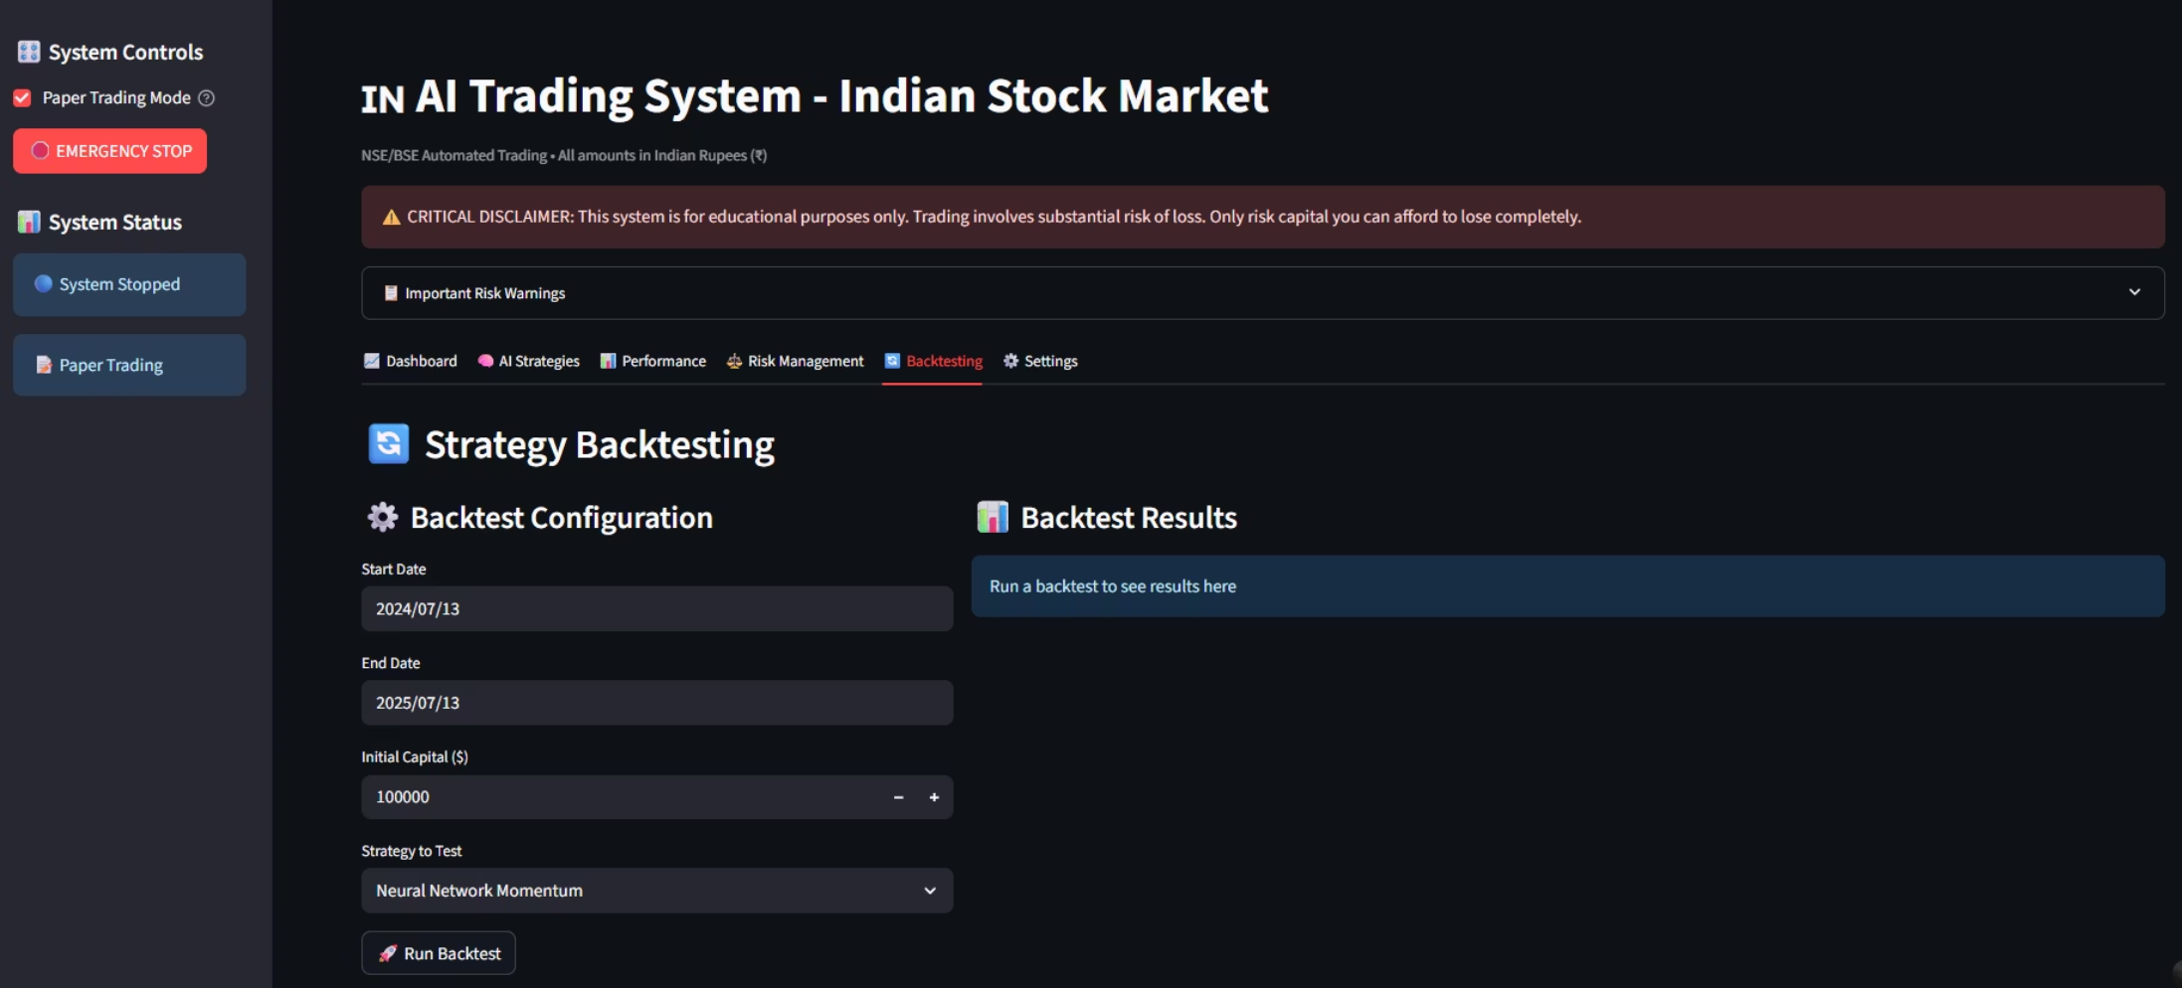
Strategy Backtesting Module – AI Trading System (Indian Stock Market)
This module allows users to simulate and evaluate trading strategies on historical data
using AI techniques like Neural Network Momentum.
Users can configure parameters such as capital, date range, and strategy type before running a backtest.
It helps in identifying profitable strategies before live deployment, minimizing real-world
risk and improving decision-making.

Slide 11
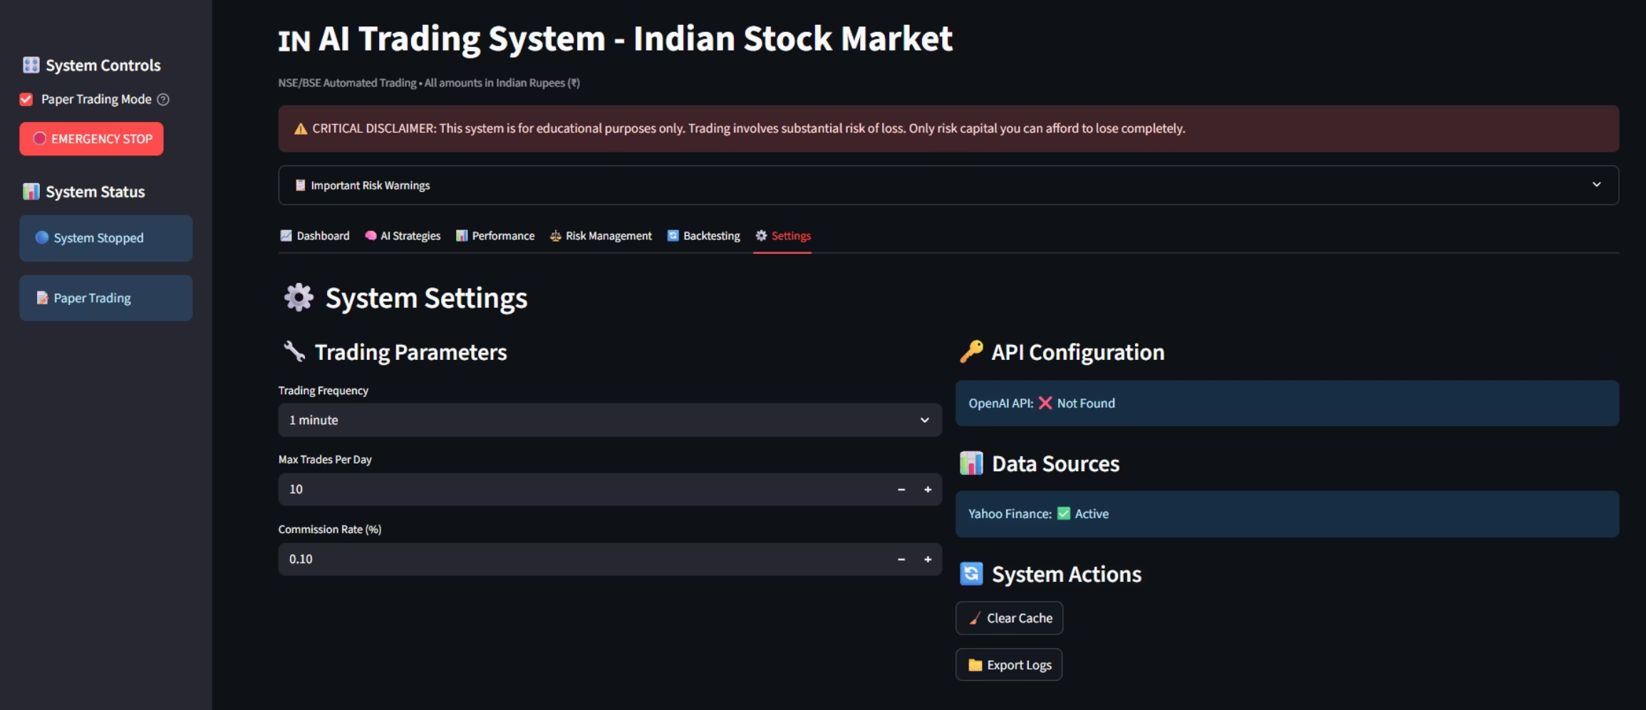
System Settings – AI Trading Platform Configuration
This panel allows users to define trading parameters such as execution frequency, max trades per day, and commission rate to simulate realistic trading conditions.
It includes API and data source integrations, such as Yahoo Finance for live data and optional
OpenAI API for AI-enhanced features.
Users can perform system maintenance tasks like clearing cache and exporting logs to ensure
smooth and auditable operation.

Slide 12




Benefits of AI Trading Genius
Accessible
Safe
Institutional-grade tools for individual investors.
Strong risk controls and paper trading mode.
Intelligent
Transparent
AI-powered insights for confident decisions.
Real-time performance and logs.

Slide 13

Disclaimer & Contact
IMPORTANT: This system is for educational purposes only. Trading involves significant risk of loss. Use only risk capital you can afford to lose.
Team: Dataslayers
Developer: MIHIR MILIND UGHADE & TEAM.
Email: mihirughade0804@gmail.com
GitHub: https://github.com/mihir0804
LinkedIn : https://www.linkedin.com/in/mihir-ughade-00601223a/

Slide 14


